Slide 1
Resistance Temple
A full stack project attempt
Colin Morrison, April 2021

Slide 2
PRODUCTION PROCESS
Four Key Processes:
Understand – Who is the project for, what do they want?
Kick-Starting – First steps and planning
Creation – Getting the first page up, and cracking on
Reflection – What could we have differently?

Slide 3
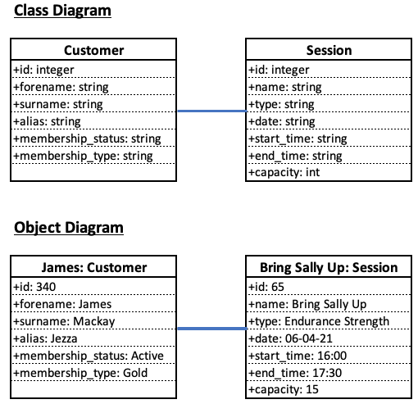
KICK-Starting Process
1) Classes & Objects
Started with a Customer, who has a ‘name’
Then a Session, also with a ‘name’
Increased properties as confidence grew
“What we NEED”
“What we WANT”

Slide 4
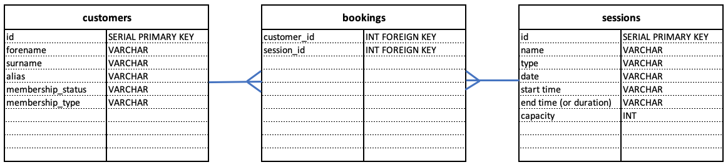
KICK-STARTING Process
2) Database Structure
A Customer can be Booked into Many Sessions
A Session can have Many Customers
The Link, is the Booking

Slide 5
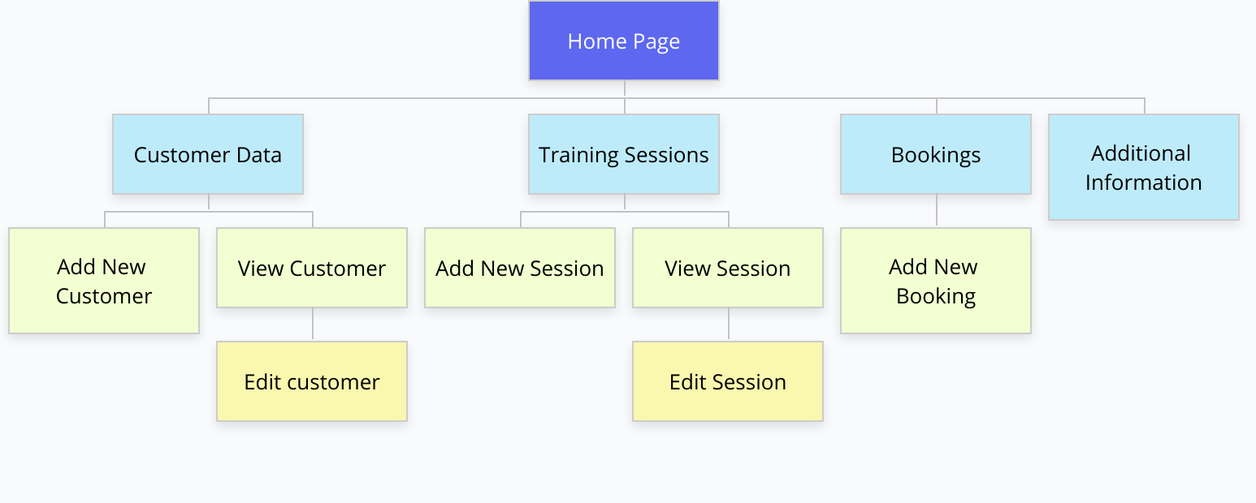
Kick-STARTING Process
3) Site Map
What we want the User to see
Start point for the file structure

Slide 6
CREATION Process
1) Create all files and folders
2) Getting it to run in the browser and show something
3) Continue adding one step at a time
Finish the NEED
4) Add in Styling
Mechanically unsympathetic on the CMD + SHIFT + R key
5) Add in extended WANTS
Additional features and verifications
6) Test, Debug, Test, Debug, Test..
7) Simplify code, remove redundant
(and retest)

Slide 7
REFLECTION - Positives
Logic
Logic was methodical and clear to understand with my naming of variables.. Etc
(few bugs!)
Additional Features and Content
“How can I beat the system?” used to find (and fix) faults with forms and verifications
Significantly more familiar with styling (CSS)

Slide 8
REFLECTION – NOT SO POSITIVES
Styling
Didn’t take the time to properly learn how to use Flex Box or similar
Ended up with fairly WET CSS, with multiple overrides
Planning
Did not manage to implement all the features I wanted
Occasionally got a bit lost, ”wait where am I? That code shouldn’t be here”

Slide 9
Reflection - IMPROVEMENTS
App Features
Membership Type needs to serve a purpose – A max number of sessions per month, or access during certain times only
Styling
Overall styling needs conflicts reduced, and Flex utilized fully
Design for mobile first

Slide 10
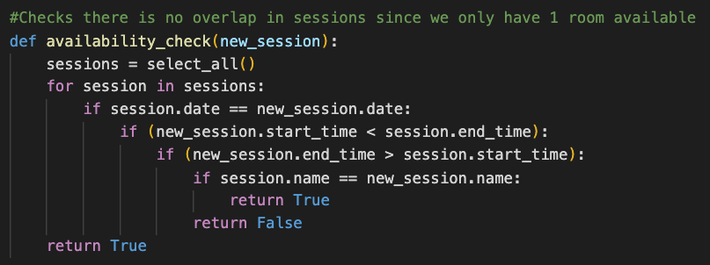
Reflection - IMPROVEMENTS
Best Practice
Little shorthand code
Highly nested if statements – Try to get a return quicker

Slide 11
{% endpres %}
(Thanks for planning this for my birthday also)

